Slide 1
Logistic Regression
Part 2

Slide 2
Classification Problem
Given Tumor size vs. Malignant data, tell if for a person with a given tumor size is malignant or not.

Slide 3
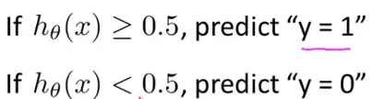
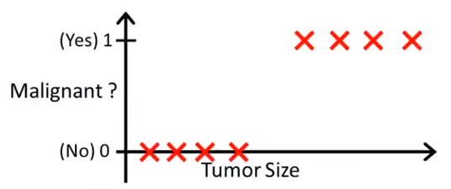

Slide 4
For Linear Regression, h(x) can be any real number.
But for a Classification problem,
0 ≤ h(x) ≤ 1
because y=0 or 1

Slide 5
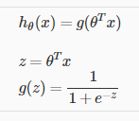
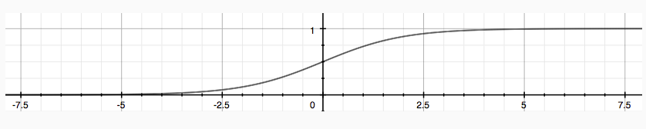
Sigmoid Function

Slide 6
Significance of Sigmoid Function
h​(x) will give us the probability that our output is 1.
For example, h(x)=0.7
h​(x)=0.7 gives us a probability of 70% that our output is 1.

Slide 7
If h(x) ≥ 0.5, then y=1
If h(x) ≤ 0.5, then y=0

Slide 8
z= 𝛳^{T}X
if z≥0 then 1/ (1+e^{-z}) ≥ 0.5
if z≤0 then 1/ (1+e^{-z}) ≤ 0.5

Slide 9
Moral of the story:
z= 𝛳^{T}X
if 𝛳^{T}X ≥0, then h(x) = 1
if 𝛳^{T}X ≤0, then h(x) = 0

Slide 10
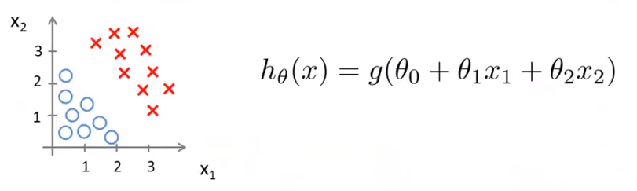
Quick Exercise
After running gradient descent on this (using Linear Regression),
𝛳 = [-3 1 1]

Slide 11

𝛳 = [-3 1 1] ^{T}

Slide 12
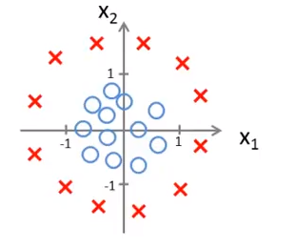
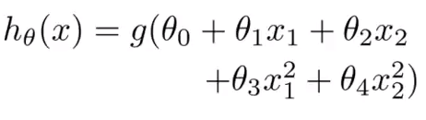
Non-Linear Boundaries
𝛳 = [-1 0 0 1 1]^{T}

Slide 13
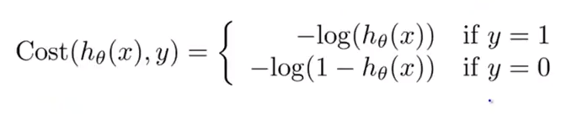
Logistic Regression Cost function
Changed to
J(𝛳) = 1/2m (𝚺_{i=1 to n}(h(x^{(i)})- y^{(i)})²)
J(𝛳) = 1/2m (𝚺_{i=1 to n}Cost(h(x^{(i)}), y^{(i)}))

Slide 14
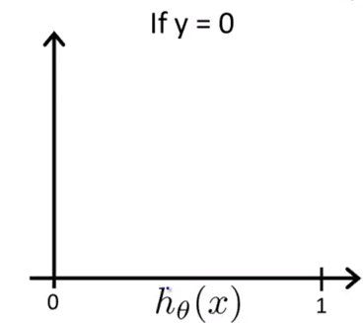
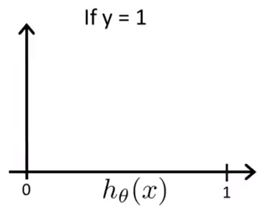

Slide 15
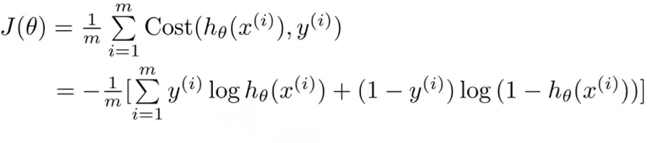
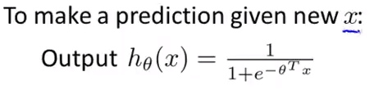

Slide 16
